Slide 1

Basic Details of the Team and Problem Statement
Ministry/Organization Name/Student Innovation:
Startup India Section, Department for Promotion of Industry and Internal Trade (DPIT), Ministry of Commerce and Industry.
PS Code: KK1178
Problem Statement Title: Develop an application for the effective mentorship of the entrepreneurial activities in country. Team Name: Mind Crusaders
Team Leader Name: Gourav Sharma
Institute Code (AISHE):
Institute Name: Bharati Vidyapeeth's College of Engineering
Theme Name: Miscellaneous

Slide 2
Idea/Approach Details
Idea Description:
Our Idea is to develop a web application that provides all the necessary tools and facilities required for a mentor to guide future Entrepreneurs.
Provide basic knowledge for starting a new business using Roadmaps.
Provide a platform where entrepreneurs can present their business ideas to mentors .
Provide platform for effective time and goal management.
Technology stack:
HTML, CSS, JavaScript – Website Frontend
NodeJS and Express – Server Backend
WebRTC Library– Video Calling Feature
MongoDB Library– Database
Machine Learning – Mentor Recommendation System

Slide 3
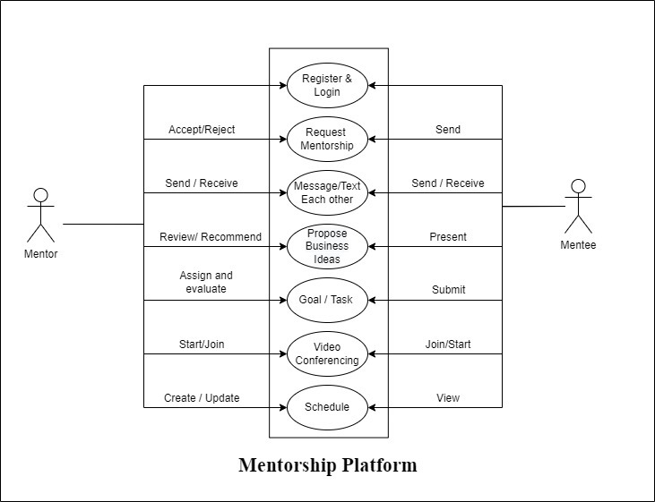
Idea/Approach Details
Use Case Diagram:

Slide 4
Idea/Approach Details
Use Cases :
Entrepreneur/Mentee:
Manage team members and Assign task to them.
Can list their ideas on the website.
Find mentors according to requirement and contact them.
Request video conferencing with mentors.
Mentors:
Analyze the ideas of the entrepreneurs
Conduct video conferencing with entrepreneurs
Assign periodic goals for their mentees
Provide daily schedule
Dependencies :
Stable internet connection
A device is required like laptop, smartphone
Working camera and microphone required

Slide 5
Team Member Details
Team Leader Name: Gourav Sharma
Branch : Btech Stream : CSE Year : III
Team Member 1 Name: Shubham Rawat
Branch : Btech Stream : CSE Year : III
Team Member 2 Name: Ayush Mittal
Branch : Btech Stream : CSE Year : III
Team Member 3 Name: Devanshu Joshi
Branch : Btech Stream : CSE Year : III
Team Member 4 Name: Priya Yadav
Branch : Btech Stream : CSE Year : III
Team Member 5 Name: Rishabh Tater
Branch : Btech Stream : CSE Year : III

